Slide 1

TOPIC A4:
MACHINE LEARNING
LESSON A4-8
LEARNING FROM REWARDS
RECOMMENDED LISTENING:
THE WONDERFUL STARS WALK IS WONDERFUL
KATAMARI DAMACY

Slide 2
AGENDA
Warm up
Learning without labels
Clustering
Association rules
Reinforcement learning
The resturaunt report
Lab
WHAT U NEED 4 LESSON
Guided Notes
ur hedz

Slide 3
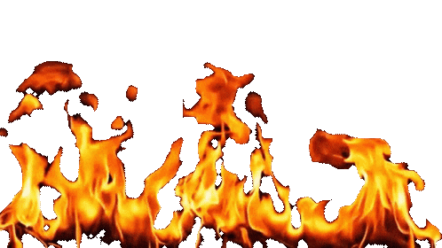
THE WARM UP QUESTION
(a) State what transparency means as an ethical issue [1]
(b) A hiring model's gender field is deleted but the bias stays. State the name for a field that stands in for a protected one [1]
(c) State what Discuss requires that Describe does not [1]
→ Notes Q1 (a), (b), (c)

Slide 4
THE WARM UP ANSWER
(a) You are given the information to understand what a system did, and why it did it
(b) A proxy variable
(c) Arguments on more than one side, weighed against one another, and a conclusion

Slide 5
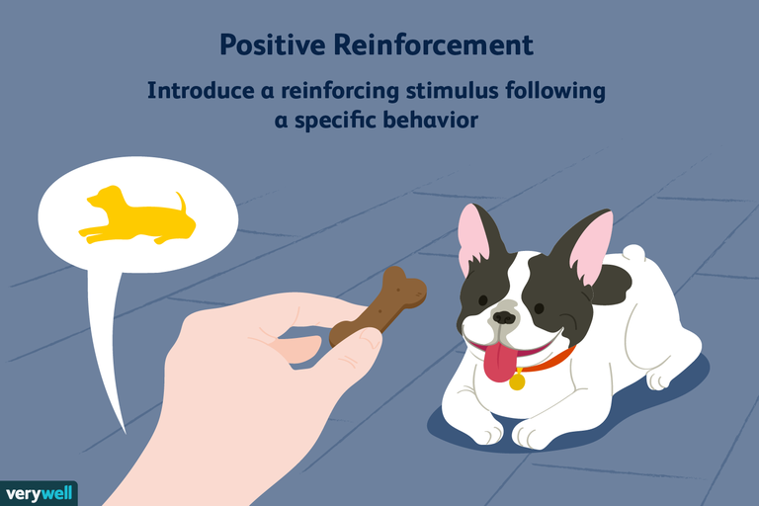
LEARNING WITHOUT LABELS
Every algorithm so far was given the answers
  Regression approximates accurately people’s heights, and the trees had the real diagnoses of people with medical conditions
This has all been supervised learning where somebody labelled the training data before it was used by the model
Today we step back into the realm of unsupervised learning
Recall that clustering and association rules are unsupervised learning where they are handed data and asked to find structure in it.
Reinforcement learning gets a reward after it performs an action, and is not label based

Slide 6
CLUSTERING
Clustering takes unlabelled data and groups together data that resembles each other
  You do NOT tell the program what the groups are, but you do tell it how many to look for
IB’s example: a shop segments its customer base using purchasing data
The output of this model will be a group number for every customer, not even a name
  You look at the data afterwards and assign names

Slide 7
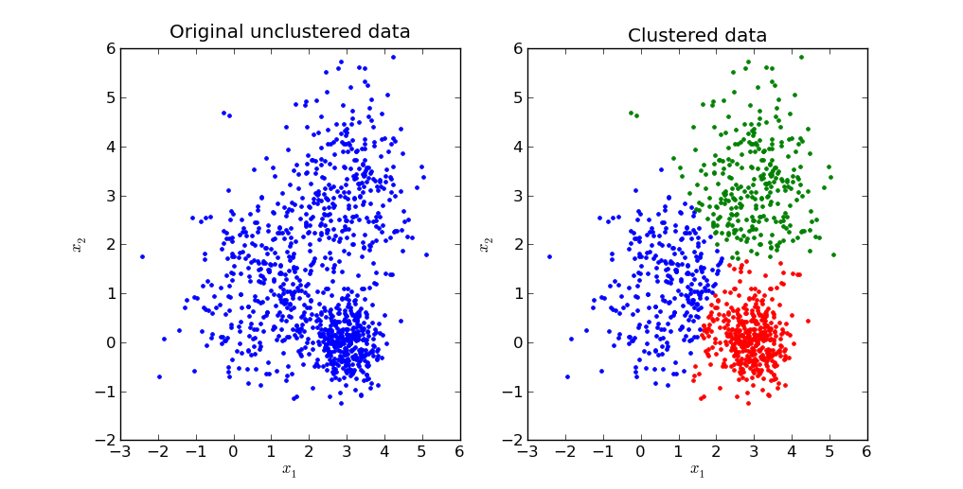
CLUSTERING

Slide 8
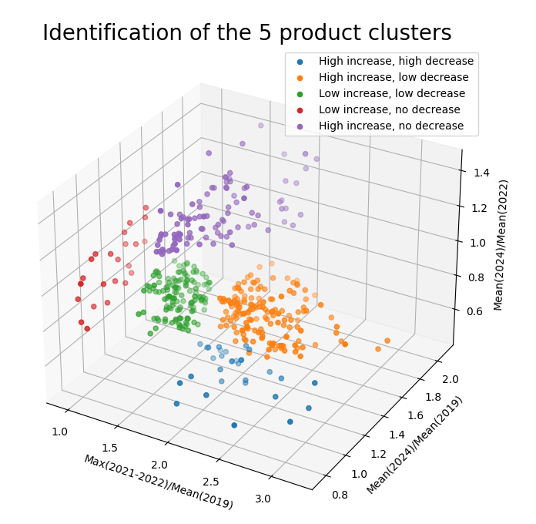
CLUSTERING

Slide 9
CLUSTERING
The usual method is k-means:
Step 1: Choose k, the number of groups, and pick k points at random. Each one is a centroid
  The word centroid will now become an insult in my lexicon
Step 2: Assign every data point to its nearest centroid.
Step 3: Move each centroid to the mean position of the points assigned to it.
Step 4: Repeat steps 2 and 3 until nothing every point is stable with its centroid. Then, you have your final clusters!
Notes:
Draw a diagram with two centroids and a dozen other dots on the board micheal

Slide 10
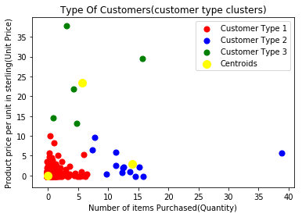
CLUSTERING
Notes:
Draw a diagram with two centroids and a dozen other dots on the board micheal

Slide 11
CLUSTERING
k is a hyperparameter (what’s a hyperparameter?)
If k is too small, two real groups may get merged
If k is too large, one real group may get split
  k-means is not k-NN from A4-5
    k-NN has labels and predicts a category for one new point
      k-means has no labels and groups things together
There is also no accuracy to calculate, because there is no correct grouping to check against
→ Notes Q2 (a) and (b)

Slide 12
ASSOCIATION RULES
An association rule attempts to establish patterns, such as two items always appearing together in the same purchase
  It is written ‘if A then B’
The guide's example is crime analysis:
  Areas with high vandalism also have high theft, giving police suggestions on where to patrol
Ours is the restaurant: 200 lunchtime transactions, six items on sale.
A rule is only worth anything once you have checked three numbers.

Slide 13
ASSOCIATION RULES
Support - how often A and B appear together, out of all the transactions
Confidence - of the transactions that contain A, the fraction that also contain B
Lift - how much more likely B becomes when A is there, compared with B on its own
  Calculate by doing confidence/percentage of orders with just B
A lift value of 1 means there is no relationship
A lift value above 1 indicates a positive connection
A life value less than 1 means those objects tend to not appear together
Support can decide if something is common, confidence lets you know how reliable the link is, lift gives more interesting data

Slide 14
ASSOCIATION RULES
Here are some restaurant rules
Five rules mined from the 200 transactions
Read the lift column before you read anything else
Rule | Support | Confidence | Lift
If Sandwich Then Fries | 0.42 | 0.70 | 1.40
If Cookie Then Energy drink | 0.15 | 0.50 | 2.50
If Fries Then Water | 0.35 | 0.70 | 1.00
Fruit → Water | 0.20 | 0.80 | 1.14
Energy drink → Cookie | 0.15 | 0.75 | 2.50

Slide 15
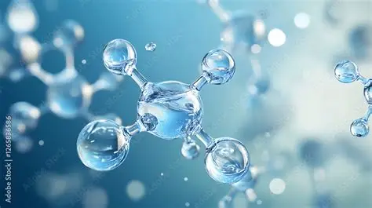
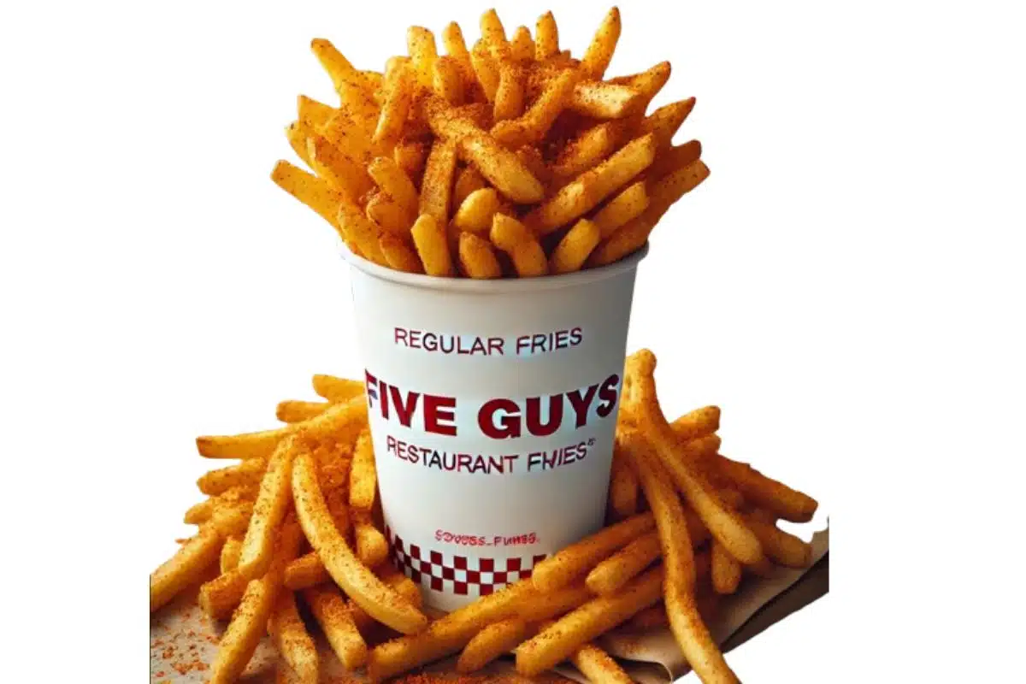
ASSOCIATION RULES
If fries then water has a confidence of 0.70, which looks strong
But water is in 140 of the 200 transactions anyway, so fries doesn’t actually give you much information
  The lift is 1, meaningless
    If you only looked at support and confidence, you’d have taken on a meaningless connection
    In this case, somebody who ordered fries is just as likely to get water as somebody who didn’t get fries, leading to the lift being 1
→ Notes Q3 (a), (b) and (c)

Slide 16
ASSOCIATION RULES
Your turn. Of the 200 lunchtime transactions, 100 contain fries, 60 contain a cookie, and 18 contain both
For the rule if fries then cookie, calculate:
  (a) the support
  (b) the confidence
  (c) the lift, and what it tells the restaurant about fries and cookies
→ Notes Q4 (a), (b) and (c)

Slide 17
REINFORCEMENT LEARNING
Switching gears now to reinforcement learning:
The agent is the program making choices
  Ours picks the restaurant’s meal deal each morning.
The environment is everything the agent acts on
  The restrunt and the people in it.
The state is what the agent knows right now
  the day, the stock, the weather
The action is what it chooses - which three items go in today's bundle
The reward is the response it gets back at the end of the day: the profit

Slide 18
REINFORCEMENT LEARNING
The policy is the rule that turns a state into an action
  “On a cold Monday, bundle the soup” is a policy
  Learning means improving it
The agent doesn’t get scored purely on profit earned today, but it is scored on cumulative reward, the total across the whole term
That matters, because a bundle that loses money today is useful information for the model to remember
But it can make it harder to isolate which of those deals it made over 40 days is the one that earned it the most money

Slide 19
REINFORCEMENT LEARNING
Every morning the agent has two it evaluates against one another:
Exploitation - serve the best bundle you already know about
  The ‘known good’ strategy
Exploration - try a new strategy you haven’t tested
  It could go great, or it could go terribly
If you always exploit, you may never find a better pattern
  Recall that all gamblers quit before their big win
If you always explore, you’ll never profit from the combos you’ve found
The usual compromise is to exploit most of the time and explore occasionally

Slide 20
REINFORCEMENT LEARNING
Assume bundle A has been served for 20 days with an average profit of $180
Now assume that bundle B has been served twice: $120 once, $240 once., still an average of $180
There are identical averages, but which one should you serve tomorrow?
  You know far less about B, so testing it might be worth more
  Two days of data isn’t enough data imo
Exploring B costs nothing in expected profit today and might raise it for the rest of term
→ Notes Q5 (a), (b) and (c)

Slide 21
THE RESTRN’T REPORT
Same restaurant, same 200 students
A clustering model was run on their purchase history with k set to 3
The algorithm produced the groups, but didn’t name them
Cluster | Students | Avg spend | Buys fruit | Visits/week
A | 82 | $2.10 | 12% | 4.6
B | 71 | $4.80 | 9% | 2.2
C | 47 | $3.20 | 68% | 3.1
Rule | Support | Confidence | Lift
If Sandwich Then Fries | 0.42 | 0.70 | 1.40
If Cookie Then Energy drink | 0.15 | 0.50 | 2.50
If Fries Then Water | 0.35 | 0.70 | 1.00
Fruit → Water | 0.20 | 0.80 | 1.14
Energy drink → Cookie | 0.15 | 0.75 | 2.50

Slide 22
THE RESTRN’T REPORT
Notes Q6 is a report form that you should fill out
Name each cluster in one phrase and give an explanation based on the data itself
Pick the one rule worth acting on and say which of the three metrics convinced you
Recommend one change to the meal deal
Then state the reward you would give an agent to find out whether your change worked
  Basically, brainstorm an improvement to the algorithm
→ Notes Q6

Slide 23
LAB
→ Notes Q7
Q7 (a) A police force finds that areas with high vandalism also have high theft. Identify the technique used and describe how the force could act on it. [3]
Q7 (b) A delivery company uses reinforcement learning to choose routes. Describe why the agent is rewarded on the total time for a whole week rather than on each delivery. [4]

Slide 24
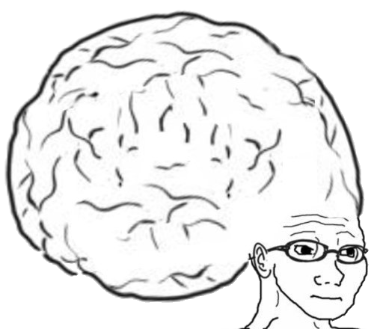
VOCABULARY TO REMEMBER
Supervised learning
Unsupervised learning
Clustering
k-means
Centroid
Association rule
Support
Confidence
Lift
Agent
Reinforcement learning
Environment
State
Action
Reward
Policy
Cumulative reward
Exploration
Exploitation

